Slide 1
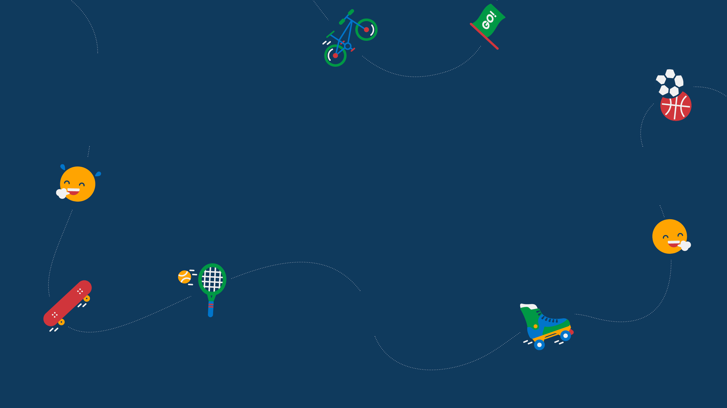
GETTING ACTIVE
いっしょに運動しよう | ISSHONI UNDŌ SHIYŌ
TRAVEL TO TOKYO
GET HAPPY!
MAKING ME HAPPY PRESENTATION
AND ACTIVITIES (LOWER PRIMARY)
WELCOME |ようこそ | YŌKOSO
HAVING FUN
たのしもう | TANOSHIMŌ
TRYING NEW THINGS
やってみよう | YATTE MIYŌ
getset.co.uk/travel-tokyo
#TravelToTokyo

Slide 2
TEACHER INTRODUCTION
About this presentation
Purpose: supports pupils to explore happiness and find ways to make themselves
and others happy by drawing on stimuli from Japanese culture and the Tokyo 2020 Olympic and Paralympic Games.
Age group: lower primary (4–7 year olds). For more challenge for pupils, refer to the upper primary resource.
Duration: approx. 20-minute assembly or classroom presentation plus an optional Active Challenge that may be delivered as an in-school challenge, a home-based challenge for pupils and their families, or a community-based challenge managed by the school.
Format and activities: includes pupil-facing information in a range of formats, interactive quizzes, pair/group discussions and opportunities for active learning; delivery notes are provided below each slide.
Supporting resources
After using this presentation with your pupils, try some of our free, printable activity ideas to keep up the momentum!
Tokyo Ten – 10-minute activities that can be played with minimal equipment at home or at school: www.getset.co.uk/resources/travel-to-tokyo/tokyo-ten
Active Challenges – take-home activity ideas for pupils and families: www.getset.co.uk/travel-tokyo/active-challenges
Curriculum fit
PSHE/Relationships/Health and Wellbeing: supports pupils to make choices that support a healthy lifestyle; recognise the importance of taking care of their mental health; meet challenges with resilience and confidence; adopt strategies and behaviours that support their health and wellbeing.
Personal Development: supports pupils to develop their character and helps them to know how to keep mentally (and physically) healthy.
PE: inspires pupils to be active and explore new physical activities; promotes a range of activities that enable them to lead healthy, active lifestyles.
Geography/Social Studies: inspires pupils’ curiosity about the world and its people; equips pupils with knowledge about diverse places, people, and natural and human environments; develops pupils’ understanding of others’ values, beliefs and culture.
Depending on the selected Active Challenge:
History/Social Studies: explores links between people and places in time; reinforces pupils’ learning about changes within living memory (Active Challenge – connect with older people).
Sciences: develops pupils’ curiosity and understanding of nature and the environment (Active Challenge – bring nature indoors).
Citizenship/Personal Development: equips pupils to be responsible, respectful and active citizens who contribute positively to society (Active Challenge – kindness).
Notes:
Teacher information
This slide will be hidden in presentation mode

Slide 3
NOTE FOR TEACHERS
Social distancing
Nurturing children’s wellbeing is even more important during the current Coronavirus pandemic than at other times. It will help them to deal with their own and adults’ anxiety. This ‘Making Me Happy’ presentation and challenges will support schools to do this.
However, to follow social distancing guidance with those pupils who are at school, some of the learning methods for the tasks may need to change. For example:
Ask pupils to sit or stand apart from each other.
Replace pair/small group discussions with individual contributions to whole class discussions.
Find fun, alternative ways for pupils to share ideas with each other, e.g. stand pupils in parallel lines and ask them to mime an example to the opposite person who must guess the answer; write ideas on post-it notes and take turns to run and stick them to a board; number pupils and then, after a certain number of claps, the pupil with the corresponding number shares an idea; ask children to write or draw ideas on a graffiti wall (a long length of paper on the floor or wall) so pupils are spaced along it or take turns to add their ideas to the wall.
Instead of pupils moving to a matching corner to give their answer, give them an action to do, e.g. A = stretch, B = crouch, C = jump, D = spin.
Please refer to the Government guidelines and your own school’s advice.
Notes:
Teacher information
WHILE CORONAVIRUS SOCIAL DISTANCING MEASURES ARE IN PLACE
This slide will be hidden in presentation mode

Slide 4
CONTENTS
Topic | Task/supporting resource | Slides
Ikigai – happiness in Japan | Introduction to Ikigai: information Benefits of Ikigai: matching activity What affects happiness: bar chart activity | 5–10
How to be happy: ways to wellbeing | Five happiness actions: information Five happiness actions: examples What makes me happy? Pair and share activity Japanese examples: information | 11–16 Choose one Japanese example from the three
Achieving balance | Balancing daily habits: information Athletes’ stories: case studies analysis | 17–20
Small steps to happiness: personal actions | Small steps possibilities: group activity Small steps pledges: promises drawing Active Challenges: information | 21–24 incl. worksheet
Signposts | Keep in touch links | 25
Notes:
Teacher information
This slide will be hidden in presentation mode

Slide 5
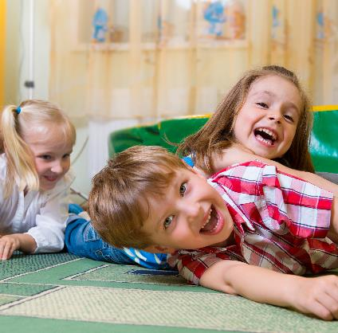
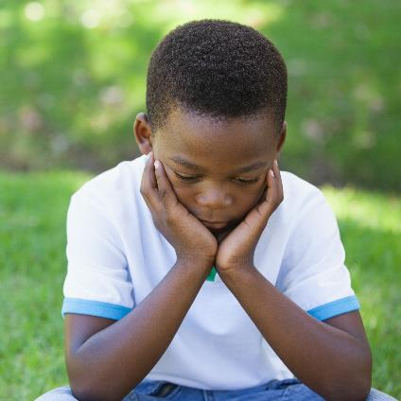
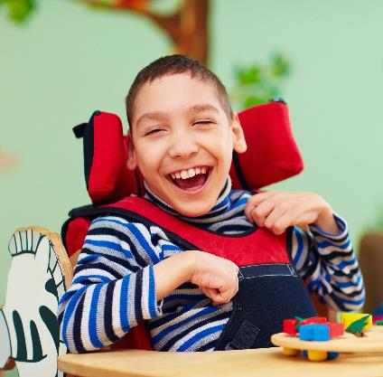

WHAT DOES HAPPINESS LOOK LIKE?
Which picture does NOT show happiness?
A
B
C
D
Notes:
DEFINING HAPPINESS – odd one out activity
Show pupils the pictures.
Talk through the options and ask them to decide whether the picture shows happiness or not - hands in the air for yes and crouch down for no.
Ask them to suggest why these children are happy or unhappy OR ask them to share an example of when they have been happy.
Reinforce that happiness is feeling good about yourselves, other people and the world. It is about heart (feelings) and head (thoughts).

Slide 6
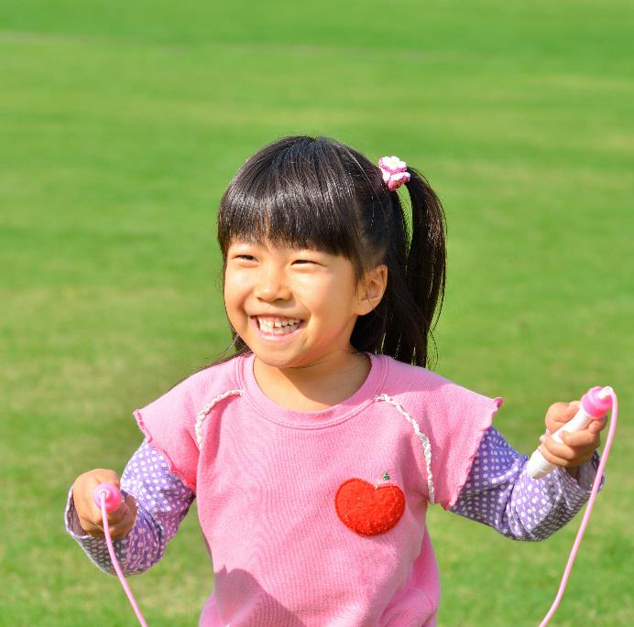
WHAT DOES HAPPINESS MEAN IN JAPAN?
Happiness in living
いきがい
Ikigai
Reason to get up in the morning
LIFE
+
VALUE
Notes:
DEFINING HAPPINESS IN JAPAN – information
Share the Japanese word: Ikigai (ik-i-gai)
There is no direct English translation, but broadly it means ‘happiness in living’.
It comes from two words: Iki (life) and Gai (value or worth), i.e. what makes life worth living or, more simply, what gives Japanese people a reason to get up in the morning.

Slide 7





IKIGAI (HAPPINESS) BRINGS THESE BENEFITS
True or false
Feel good
Be rich
Do well
in school
?
?
?
?
Win prizes
Be healthy
Live well
for longer
?
?
?
?
Notes:
IDENTIFYING THE BENEFITS OF IKIGAI (HAPPINESS) – active matching activity
Reveal the pictures in turn and ask pupils to decide if it is true or false that this is a benefit of ikigai (happiness).
Encourage active learning: stretch or stand for true/sit or crouch for false.
Click again to reveal the answer before revealing the next picture.
Happiness contributes to:
Good physical health
Good mental health and emotional wellbeing
An active mind
Longevity (ageing well)

Slide 8
CHANGING HOW HAPPY YOU ARE
Japanese people believe:
Ikigai
=
“Japanese people believe
that the sum of small joys
in everyday life results in
a more fulfilling life as a whole.”
(Akihiro Hasegawa)
PURPOSE
+
ACTION
Notes:
CHANGING HOW HAPPY YOU ARE – information
Research by Akihiro Hasegawa (2001) – a clinical psychologist – found that Japanese people believe happiness in life comes from the sum of small joys. This means you can still have ikigai – and look forward to things – even if you are having a sad moment.
They also believe that it isn’t enough to value or have a purpose in life; ikigai comes from putting those values and that sense of purpose into action.

Slide 9


Our choices and actions
HOW MUCH CAN YOU CONTROL HOW HAPPY YOU ARE?
I have
total control
I have some control
I have no control
Notes:
CHANGING HOW HAPPY YOU ARE – activity
Ask pupils to stand up. Explain they will show the answer by touching the relevant part of their bodies:
Hands on heads – they have total control over whether they are happy or not
Hands on hips – they have some control
Touch toes – they have no control
Explain, then on ‘go’ ask them to show what they think.
Reveal the answer – we have some control, just less than half (data from Action for Happiness).
Our genes have an approx. 50% influence on how happy we are (some people are naturally happier than others).
External circumstances only have approx. 10% influence (e.g. income, environment, etc.)
Our choices and actions (behaviours) have approx. 40% influence – therefore we CAN make choices/take actions to affect our happiness.
Emphasise that pupils can’t control everything they feel, but they can make some difference: they can make choices and take action to feel happier.

Slide 10
“Happiness is not
something ready made.
It comes from your
own actions.”
Dalai Lama
Notes:
RECOGNISING THE NEED FOR ACTION – information
Explain this session encourages pupils to consider the small joys in their lives and how they can make them happen through action.
Explain that, later in the session, pupils will identify some simple actions and challenges they can do – at school, at home and wider.
Additional Information: The Dalai Lama is the head monk of Tibetan Buddhism. Tibetan Buddhists believe that the Dalai Lama is the god of compassion who comes to Earth to help people.

Slide 11
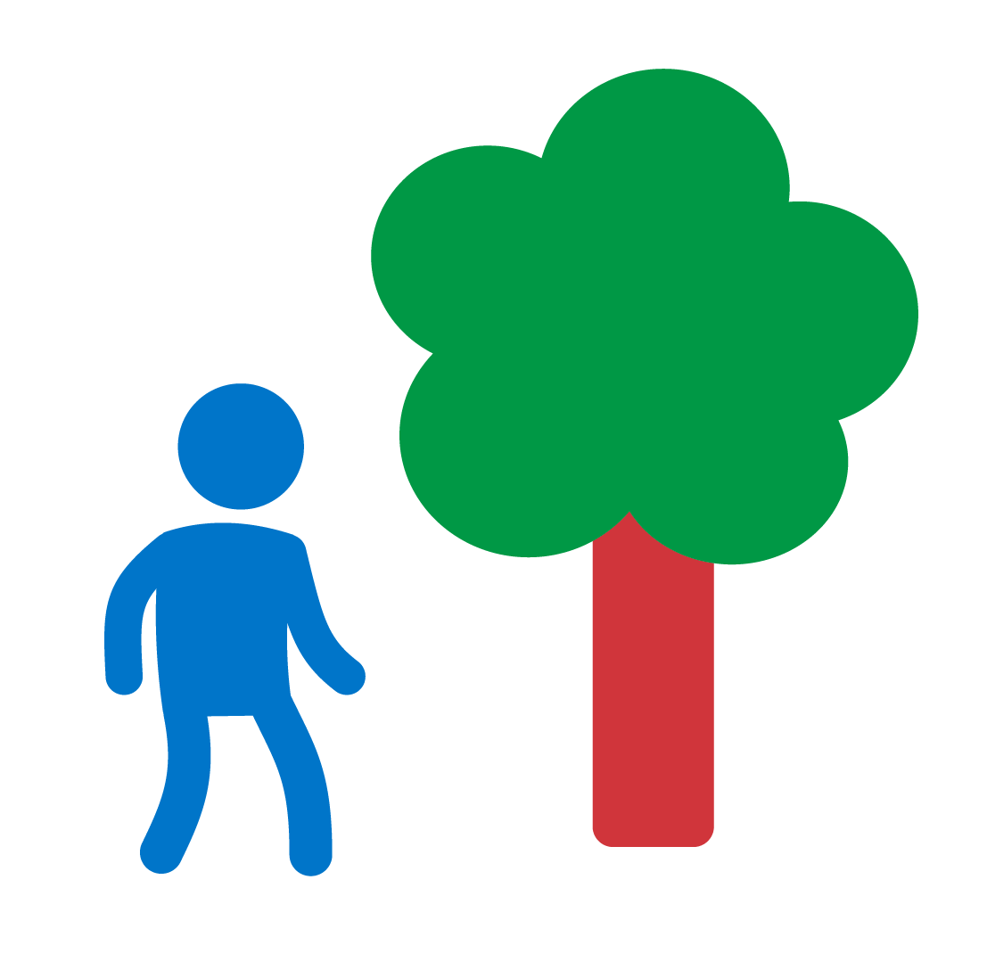




FIVE WAYS TO WELLBEING: OUR HAPPINESS ACTIONS
Connect
to people and nature.
Notice
be aware
of moments
and details.
Move
be active.
Discover
try new things and keep learning.
Give
be kind and
help others.
Notes:
IDENTIFYING THE FIVE WAYS TO WELLBEING – information
Use the slide to share the five happiness actions: these are things that pupils can do to help make themselves and others happy.
Connect – to people and nature (positive relationships are critical to wellbeing; connecting to nature is proven to improve wellbeing).
Notice – be aware of moments and details (take time to appreciate things; mindfulness; focus on here and now instead of worrying about past/present).
Move – be active, sit less and get outside (being physically active is as good for our mental/emotional health as our physical health).
Discover – try new things and keep learning (curiosity and learning new skills keeps our brains active and healthy – and builds confidence).
Give – be kind and help others (this includes small kindnesses – smiling or saying thank you – as well as ‘service’ or volunteering).
Clarify that the actions may be linked; they are not necessarily separate, e.g. by helping people, you are also connecting to them.
The following slides provide activities to deepen/test pupils’ understanding and provide examples.
Background information for teacher: Five Ways to Wellbeing is a set of evidence-based public mental health messages aimed at improving the mental health of the UK population. They were developed by a government think-tank in 2008 and are used across the UK by national and local agencies. Mind produces a simple summary for adults: https://www.mind.org.uk/media/4220803/five-ways-to-wellbeing_poster.pdf The Travel to Tokyo resources have tweaked the language of the five ways to wellbeing but the principles are the same.

Slide 12
OUR HAPPINESS ACTIONS – EXAMPLES
Connect
Notice
Move
Discover
Give
I walk in the park with my family.
I pay attention to birds singing.
I play in the garden.
I learn to say
and spell new words in a story.
I say please
and thank you.
Notes:
IDENTIFYING THE FIVE WAYS TO WELLBEING – information
Use the slide to share the five happiness actions: these are things that pupils can do to help make themselves and others happy.
Connect – to people and nature (positive relationships are critical to wellbeing; connecting to nature is proven to improve wellbeing).
Notice – be aware of moments and details (take time to appreciate things; mindfulness; focus on here and now instead of worrying about past/present).
Move – be active, sit less and get outside (being physically active is as good for our mental/emotional health as our physical health).
Discover – try new things and keep learning (curiosity and learning new skills keeps our brains active and healthy – and builds confidence).
Give – be kind and help others (this includes small kindnesses – smiling or saying thank you – as well as ‘service’ or volunteering).
Clarify that the actions may be linked; they are not necessarily separate, e.g. by helping people, you are also connecting to them.
The following slides provide activities to deepen/test pupils’ understanding and provide examples.
Background information for teacher: Five Ways to Wellbeing is a set of evidence-based public mental health messages aimed at improving the mental health of the UK population. They were developed by a government think-tank in 2008 and are used across the UK by national and local agencies. Mind produces a simple summary for adults: https://www.mind.org.uk/media/4220803/five-ways-to-wellbeing_poster.pdf The Travel to Tokyo resources have tweaked the language of the five ways to wellbeing but the principles are the same.

Slide 13
WHAT MAKES YOU HAPPY?
Connect
Give
Notice
Move
Discover
Notes:
EXPLORING PUPIL ACTIONS – activity
In pairs, ask pupils to think about a time when they were happy: what made them happy?
For a more active option: ask them to stand and move to find a partner, then move again to find another partner (staying standing as they share).
Share some examples in the whole class.
Explain that pupils will think about actions they can do in future later in the session.
The following slides provide Japanese-related examples.
Challenge: show the examples one by one and ask pupils to say which of the happiness actions they are.
Support: share each example one by one and ask pupils to suggest similar examples from their own lives.

Slide 14
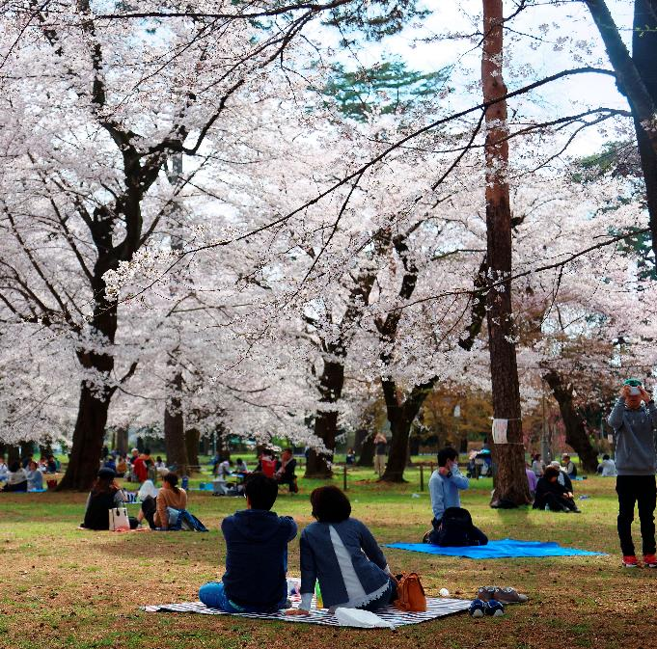
O-HANAMI
Which happiness actions
are involved?
In spring, Japanese people go to view cherry trees in blossom (Sakura). This is called O-Hanami.
People have picnics and eat Sakura Mochi – sweet rice cakes wrapped in leaves.
Notes:
HAPPINESS ACTIONS IN JAPAN – examples/activity
There are three Japanese examples; select the one that suits your pupils/links to an Active Challenge they might do after the session.
After describing each example, ask pupils to suggest which of the happiness actions are involved in that example.
To create an active learning opportunity, call out the actions and ask pupils to jump up/stand/stretch if they think it is involved.
If necessary, clarify how that action is being shown.
O-Hanami answers could include:
Connect – people gather with friends, families and strangers; they connect with the trees and blossom.
Notice – the trees only blossom for a short period – and the petals are easily blown away – so people have to appreciate them at the time.
Move – as many of the trees are in parks, people will walk around to look at them.
Discover – young people learn to make the Sakura Mochi from their elders.
Give – people bring gifts of food – usually homemade – to eat at the picnics.
Challenge: ask pupils to suggest how the happiness actions are shown within the example.
N.B. The Active Challenge (bring nature indoors) links to this example.
During the period of social distancing, this Active Challenge has been adapted to encourage the children to bring the outdoors in. If you share this example, please explain this is what Japanese people usually do in spring but, during the Coronavirus pandemic, they will watch the cherry blossom through the window or look at photos of last year’s trees.

Slide 15
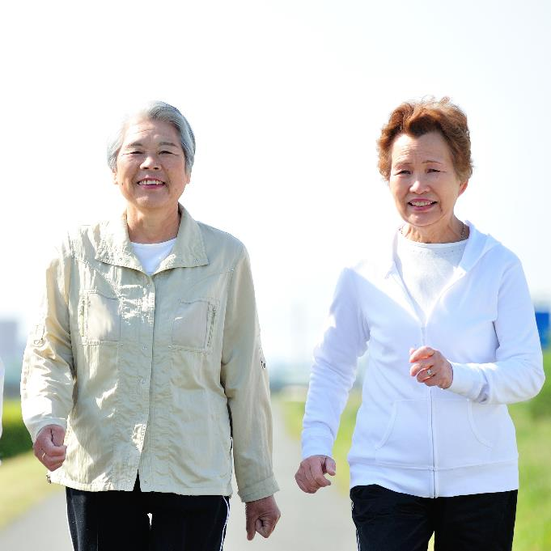
KEIRŌ-NO-HI
Which happiness actions
are involved?
Japan has many older people.
They are very active and respected.
Keirō-no-Hi (Respect for the Aged Day) is a public holiday. It celebrates older people. For example, schools give performances or older people take part in fitness displays.
Notes:
HAPPINESS ACTIONS IN JAPAN – examples/activity
There are three Japanese examples; select the one that suits your pupils/links to an Active Challenge they might do after the session.
After describing each example, ask pupils to suggest which of the happiness actions are involved in that example.
To create an active learning opportunity, call out the actions and ask pupils to jump up/stand/stretch if they think it is involved.
If necessary, clarify how that action is being shown.
Keirō-no-Hi answers could include:
Connect – young and older people are connected with each other through events.
Notice – young people in Japan make time for and appreciate older people for their wisdom.
Move – a high number of older people in Japan are still very active; they take part in the fitness displays and events.
Discover – young and older people learn new skills and activities from each other.
Give – young people put on activities and performances for older people.
Challenge: ask pupils to suggest how the happiness actions are shown within the example.
N.B. The Active Challenge (connect with older people) links to this example.
During the period of social distancing, this Active Challenge has been adapted to encourage the children to connect with older people within their family and/or use other media to connect to those outside their home, e.g. phone call, screen calls (Skype, Zoom, FaceTime, etc.), messaging, email or post.

Slide 16
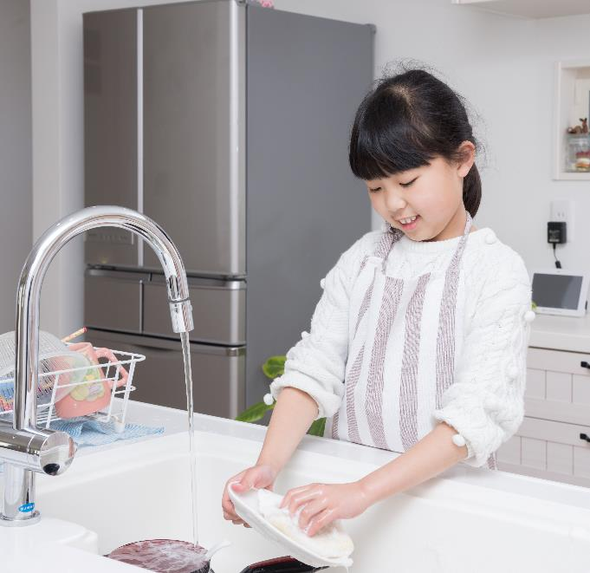
OMOIYARI
Which happiness actions
are involved?
Omoiyari is very important in Japan.
It means being kind and helping
someone before they ask for help.
It can be a large or small act
of kindness.
For example, in Japan, pupils clean
their schools and serve the lunch.
Notes:
HAPPINESS ACTIONS IN JAPAN – examples/activity
There are three Japanese examples; select the one that suits your pupils/links to an Active Challenge they might do after the session.
After describing each example, ask pupils to suggest which of the happiness actions are involved in that example.
To create an active learning opportunity, call out the actions and ask pupils to jump up/stand/stretch if they think it is involved.
If necessary, clarify how that action is being shown.
Omoiyari answers could include:
Connect – people connect by being kind to and helping each other.
Notice – to anticipate someone’s needs you need to pay attention to them and to what is happening.
Move – helping others often includes doing physical tasks, such as cleaning.
Discover – to be helpful, you may need to learn new skills or try new activities.
Give – giving is not about money or things; being kind and helping others means giving time, energy and ideas.
Challenge: ask pupils to suggest how the happiness actions are shown within the example.
N.B. The Active Challenge (kindness) links to this example.
During the period of social distancing, this Active Challenge has been adapted to encourage the children to be kind to and help others at home or use other media to support others outside their home. If pupils are at school, they can explore helping other pupils in school, in accordance with your social distancing guidance in school.

Slide 17
TO BE ABLE TO DO THE HAPPINESS ACTIONS,
WE NEED TO BALANCE…
indoors / outdoors
screen time / real time
working / playing
sitting / standing
awake / asleep
energy in / energy out
Notes:
FINDING BALANCE – information
Explain that to help us to do the happiness actions we need to have a good balance in our daily habits; balance also supports our health and wellbeing.
Support (and/or active learning option): ask children to face a partner and, holding hands, see if they can both lean away from each to keep a balance (this depends on how much balance work they have done in PE); ask what keeps them balanced, i.e. pulling equally/one person not being heavier/stronger than the other; that’s what we are trying to do with our daily habits – not do too much of one thing and too little of another.
Balance doesn’t mean doing exactly the same amount of two things every day (e.g. waking/sleeping) but, generally, balancing them across the week.
N.B. ‘energy in’ and ‘energy out’ is a very simplistic summary of the need to balance eating with activity. We do not want to promote calorie-counting with pupils! They just need to recognise that if you keep eating without exercising you are likely to put on weight and vice-versa. See Change4Life if you want to explore nutrition and healthy eating in more depth with pupils: https://www.nhs.uk/change4life/food-facts
N.B. During the period of social distancing, avoid the active balancing activity. If necessary, use a set of scales to demonstrate balance to pupils who do not understand the concept.
The following slides show how Olympic and Paralympic athletes balance their sporting and wider lives and find time for the happiness actions.

Slide 18

HOW DO ATHLETES FIND BALANCE AND STAY HAPPY?
It’s really important for athletes to
be able to focus on their sporting performance when it matters,
but also be able to switch off from
that sporting lifestyle sometimes.
Notes:
FINDING BALANCE AND MAKING MYSELF HAPPY – athletes’ examples
Use the two slides to share how Olympic and Paralympic athletes balance their sporting and wider lives and find time for the happiness actions.

Slide 19

HOW DO ATHLETES FIND BALANCE AND STAY HAPPY?
Bradley Forbes-Cryans is a Scottish slalom canoeist who
has been selected to represent Team GB at the Tokyo 2020 Olympic Games. Bradley finds balance by:
staying connected with his friends and family
keeping active outside of his sport,
by running and playing golf
learning new languages so he can communicate with foreign athletes and competitors.
“Every evening, I think about a specific point in the day when I did something good or something went particularly well.”
Bradley’s top tip for feeling happy
Notes:
FINDING BALANCE AND MAKING MYSELF HAPPY – athletes’ examples
Use the two slides to share how Olympic and Paralympic athletes balance their sporting and wider lives and find time for the happiness actions.

Slide 20
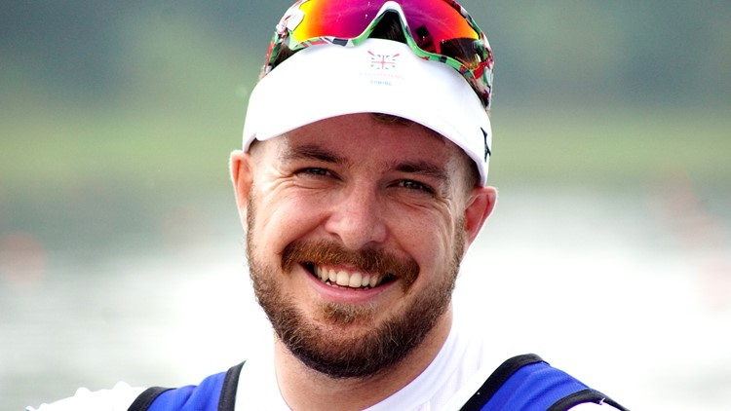
HOW DO ATHLETES FIND BALANCE AND STAY HAPPY?
Benjamin Pritchard is a Welsh para rower who is hoping to represent Great Britain at the Tokyo 2020 Paralympic Games.
He only took up rowing in late 2016. Benjamin finds balance by:
taking time to treasure and appreciate
the small things in life
sharing and swapping homegrown
vegetables with his neighbours.
staying well connected with his family
using all forms of social media
Benjamin’s top tip for feeling happy
“Do whatever puts a smile on your face.
Do not worry about what other people think of it. If it makes you smile and happy then
it is 100% worth it.”
Notes:
FINDING BALANCE AND MAKING MYSELF HAPPY – athletes’ examples
Use the two slides to share how Olympic and Paralympic athletes balance their sporting and wider lives and find time for the happiness actions.

Slide 21
WHAT SMALL STEPS WILL I TAKE?
At school
At home
Help people with their sums.
Play with friends.
Read a new story.
Look at objects on
the nature table.
Eat a new food at lunch.
Put my toys away.
Play with my brother or sister.
Watch the rain on the window.
Learn a new song.
Go for a walk with my family.
Notes:
IDENTIFYING POTENTIAL ACTIONS – pick and mix activity
Remind pupils that they can help to make themselves and others feel happy by taking actions.
Explain that small actions that pupils will do are better than big intentions that never happen. Small steps are good!
Share the examples on the slide. Reinforce these are just examples. Pupils need to do happiness actions that fit their interests and fit in with their home lives.
Emphasise the need for pupils to seek permission from parents/carers and teachers as appropriate.
In small groups, EITHER ask pupils to choose one example from school OR give each group an example.
Ask them to think about when and how they could do that action. Take feedback from each group.
Support: work through the examples as a class.
Challenge: ask pupils to come up with similar or additional examples.
Work through the ‘at home’ examples in the same way.
During the period of social distancing, suggest alternative actions (or ask the pupils to suggest them) in accordance with your school’s guidance. For example:
Pupils could use personal wipe-boards/tablets/paper to share times-tables answers with a partner instead of sitting together in pairs.
Pupils could create a new playground game that doesn’t involve being too close to each other or sharing any equipment, e.g. throw golf around a well spaced course of mini-targets, where each pupil keeps their own throwing implement.
Families (within the same household) are still allowed to go for a walk together during their one outdoor exercise session a day (if they have no symptoms).

Slide 22

MY HAPPINESS PLEDGE
To make myself and others happy I will…
Draw what I will do at school.
Draw what I will do at home.
Notes:
PROMISING TO TAKE ACTION – activity
EITHER during or after the session, ask pupils to draw promises on the front of a postcard. These should be practical actions (small steps) they can do at school and at home. They could add keywords to the back of the postcard to match the actions.
Help pupils to address the postcard to themselves and EITHER take it home to stick on the fridge (or similar) OR gather them in at the end of the class, then re-issues them after a week or so as a reminder.
Alternatively, pupils could just make a verbal promise but experience shows that people are more likely to keep a written pledge. (You could also use the promises as evidence of pupils’ personal development/wellbeing by revisiting them and evaluating their impact at a later stage.)

Slide 23
Notes:
PERSONAL PROMISE activity sheet – to copy if required (2 postcards per A4 sheet)

Slide 24
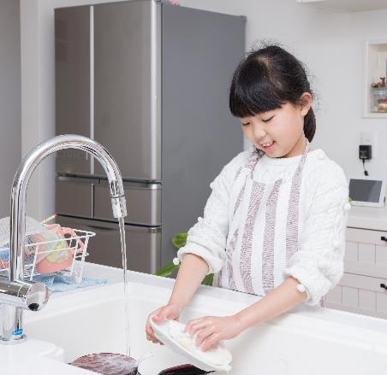

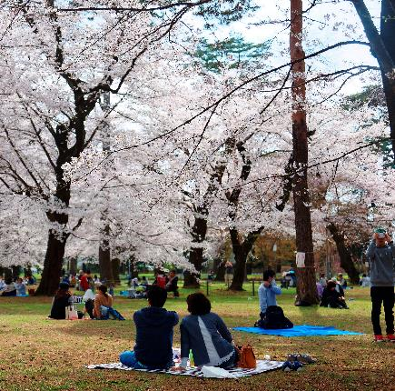
MAKE ME HAPPY CHALLENGE!
We are going to…
Connect with nature.
Play an older person’s game.
Be kind and help someone.
Let’s make ourselves happy!
Notes:
OPTIONAL – DO AN ACTIVE CHALLENGE AS A CLASS OR ASK PUPILS TO DO ONE AT HOME
Choose one of the challenges and highlight it on the slide.
Download the Active Challenges from: https://www.getset.co.uk/travel-tokyo/active-challenges
Explain to pupils what you are going to do and when, and involve them in planning the challenge.
And/or signpost them/their families to the challenges so they can do them at home.
N.B The Active Challenges have been adapted to reflect social distancing measures during the Coronavirus pandemic.
Additional links for teachers:
Bring nature indoors: The Woodland Trust provide information and activities relating to British wildlife: https://www.woodlandtrust.org.uk/
Connect with older people: Age UK promotes intergenerational projects. Contact a local group or visit https://www.ageuk.org.uk/get-involved/volunteer/local-services-volunteer/ or for examples of random acts of kindness (which link to the third Active Challenge): https://www.ageuk.org.uk/get-involved/volunteer/small-acts-of-kindness/
Kindness: the #iwill campaign encourages children and young people to get involved in service/volunteering from a young age: https://www.iwill.org.uk/

Slide 25


See how the nation is getting active:
getset.co.uk/show-tell
Share your activities at:
getset@getset.co.uk
#TTTYourWay
@GetSetCommunity (Twitter) or
@GetSetClub (Instagram)
Contact us:
getset@getset.co.uk
Notes:
TEACHER INFORMATION

